Slide 1

Indexing for Dummies
Koen Verbeeck

Slide 2

























Thank you, partners 💖

Slide 3








Contact
Koen Verbeeck
former
@Ko_Ver
@koenv.bsky.social
SQLkover.com

Slide 4




Merch

Slide 5
Outline
01
What are indexes?
02
Clustered Indexes
03
Nonclustered Indexes
04
Other Types of Indexes
05
Indexes in Other Engines
06
Maintenance

Slide 6
What are indexes?

Slide 7

Indexes are …
Notes:
because you can fix a massive performance issues with a query using a single index. Suddenly a query that runs for minutes or hours can finish in seconds or even less

Slide 8

they make stuff go faster in your database
Notes:
especially SELECT queries

Slide 9

… but not always
Notes:
INSERTS will be slower, DELETES & UPDATES might be slower, might be faster, it depends

Slide 10
An index is an on-disk or in-memory structure associated with a table or view that speeds retrieval of rows from the table or view
Microsoft Learn

Slide 11
Clustered Indexes
your best friend in SQL Server

Slide 12
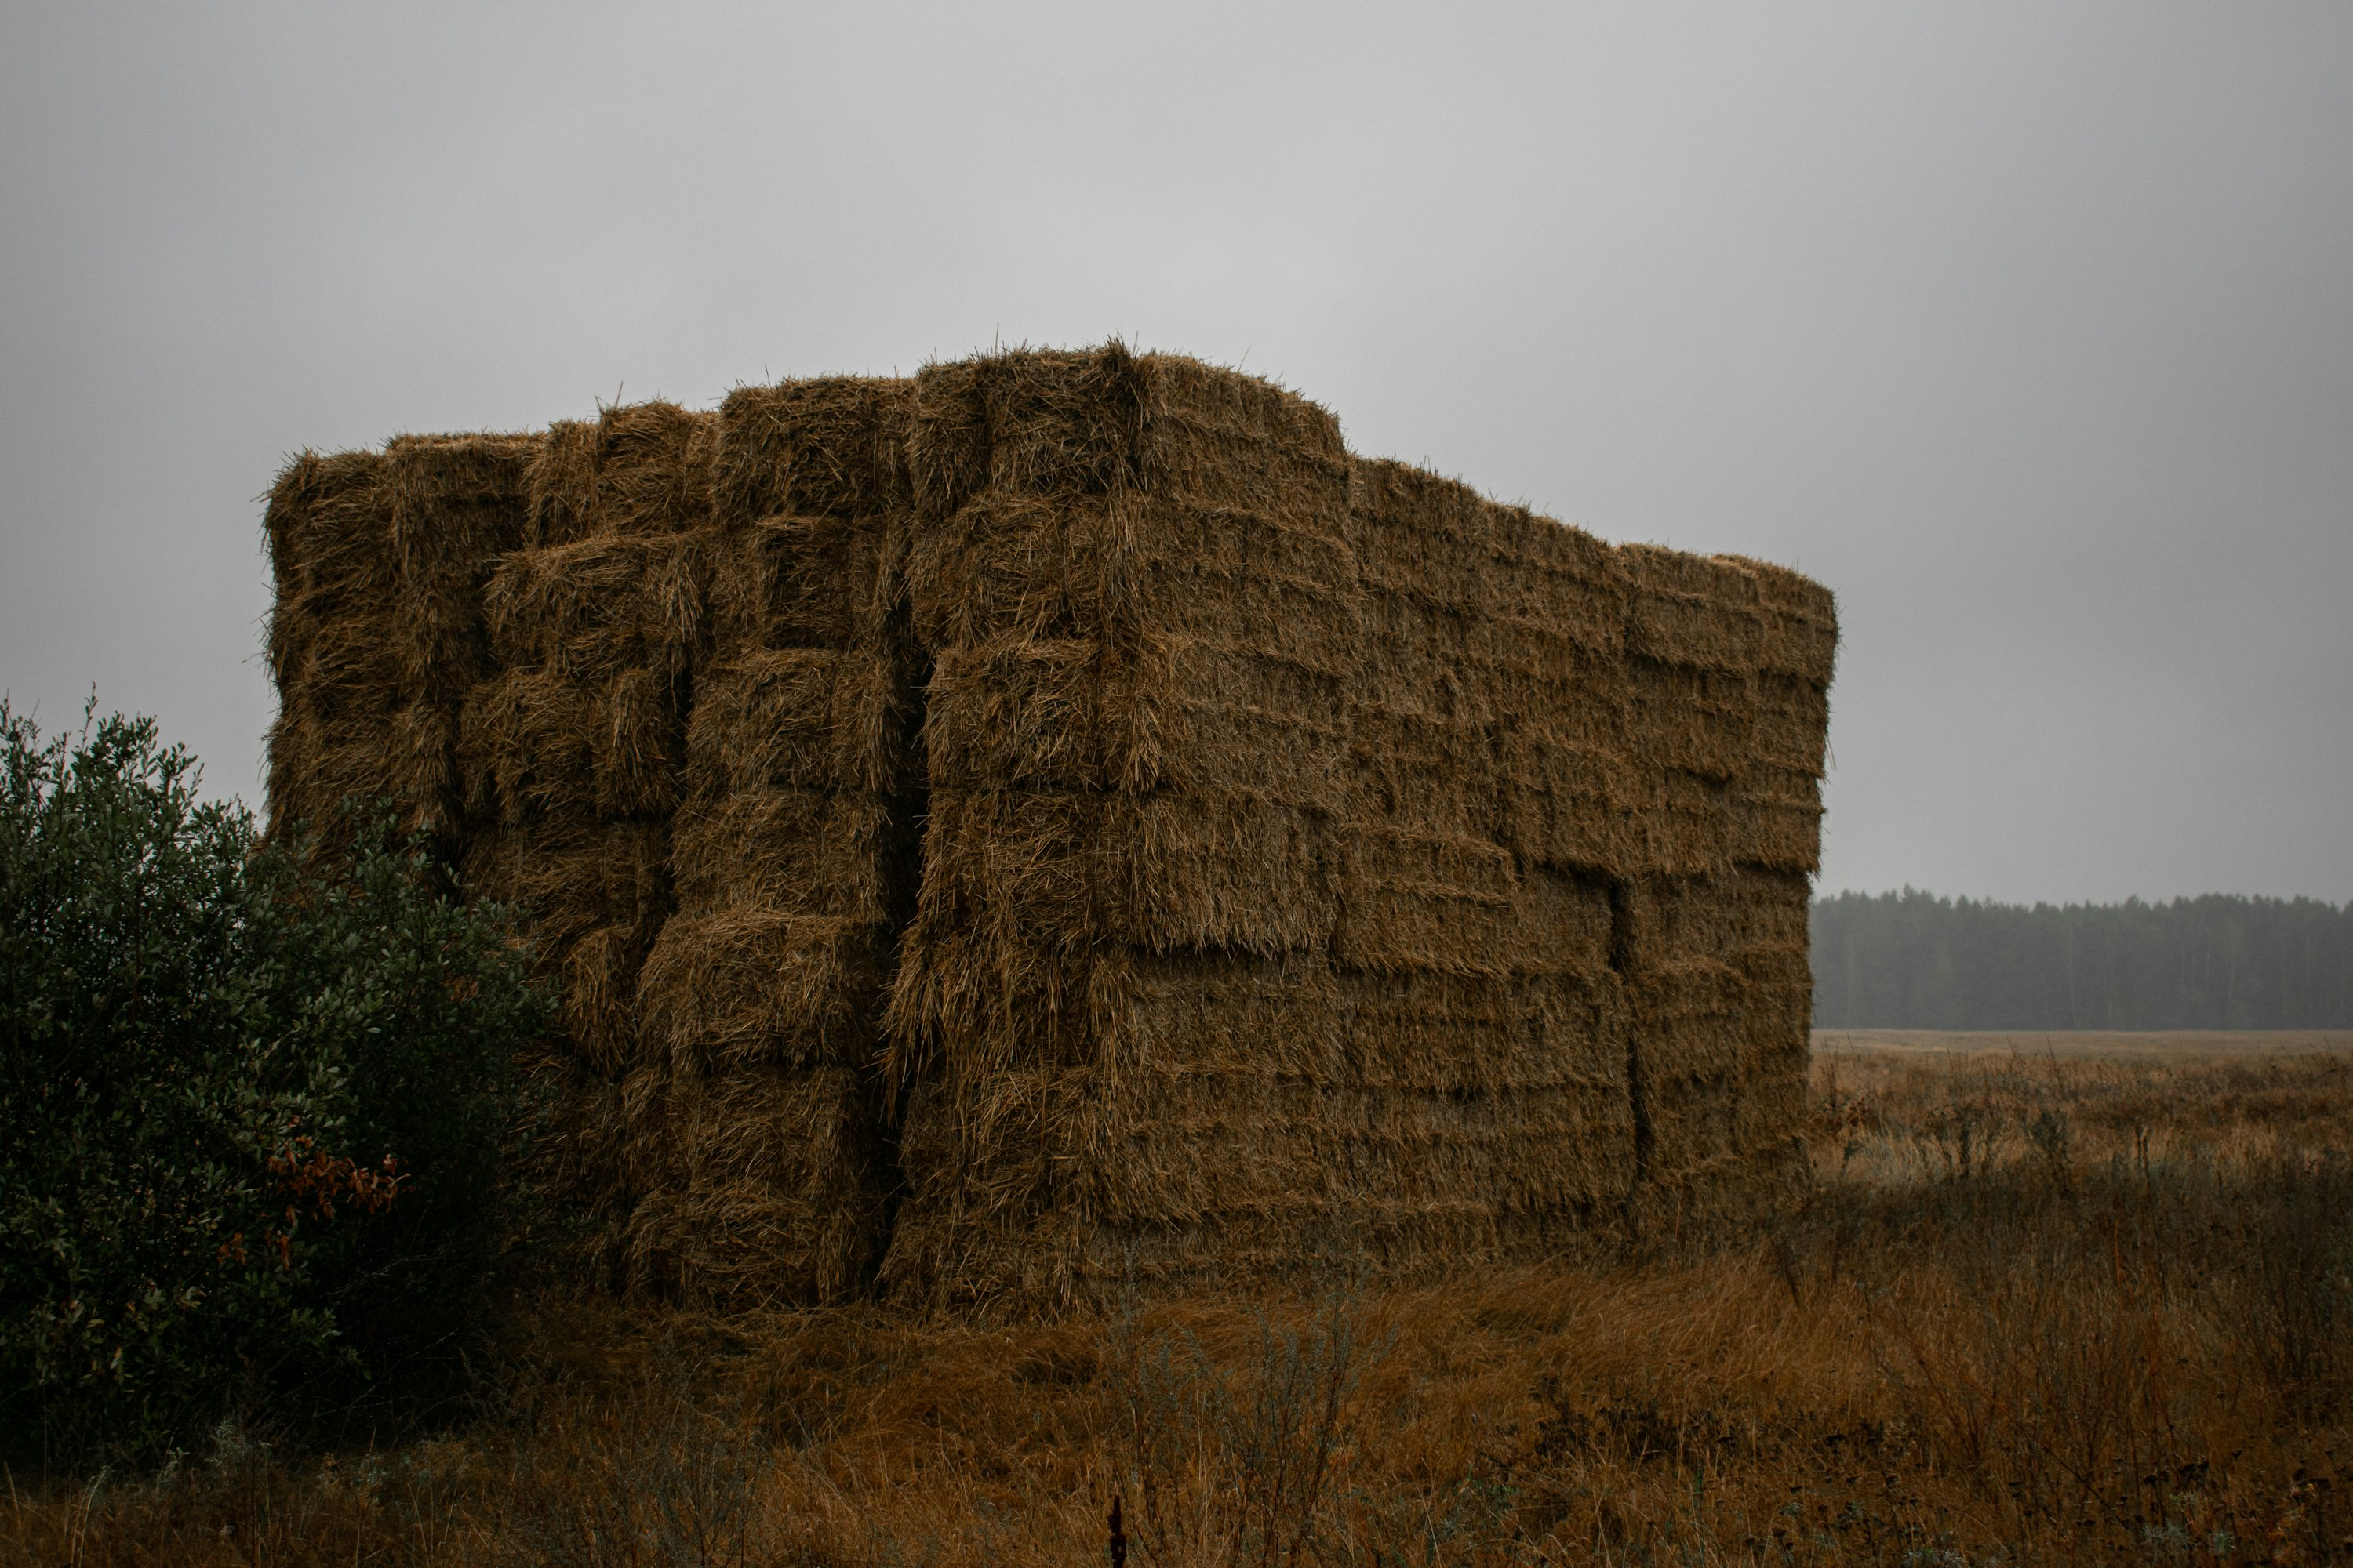
Notes:
a table without a clustered index is a heap. Looking for a row means scanning through the whole table.

Slide 13


Slide 14
the clustered index IS THE TABLE

Slide 15
root level
1-42
intermediate level
1-21
22-42
1-10
11-21
22-32
33-42
leaf level
1-5
6-10
11-16
17-21
22-26
27-32
33-37
38-42
Table Data
Data Page
Data Page
Data Page
Data Page
Data Page
Data Page
Data Page
Data Page

Slide 16
SELECT * FROM MyTable WHERE myColumn = 15;
1-42
1-21
22-42
1-10
11-21
22-32
33-42
1-5
6-10
11-16
17-21
22-26
27-32
33-37
38-42
Table Data
Data Page
Data Page
Data Page
Data Page
Data Page
Data Page
Data Page
Data Page

Slide 17
SELECT * FROM MyTable WHERE myColumn = 15;
1-42
1-21
22-42
1-10
11-21
22-32
33-42
1-5
6-10
11-16
17-21
22-26
27-32
33-37
38-42
Table Data
Data Page
Data Page
Data Page
Data Page
Data Page
Data Page
Data Page
Data Page

Slide 18
SELECT * FROM MyTable WHERE myColumn >= 22;
1-42
1-21
22-42
1-10
11-21
22-32
33-42
1-5
6-10
11-16
17-21
22-26
27-32
33-37
38-42
Table Data
Data Page
Data Page
Data Page
Data Page
Data Page
Data Page
Data Page
Data Page

Slide 19
Syntax
CREATE [UNIQUE] CLUSTERED INDEX CI_myindex ON myschema.mytable(column1 ASC, column2 DESC, …) [WITH (DATA_COMPRESSION = PAGE)];
ALTER TABLE myschema.mytable ADD CONSTRAINT PK_mytable PRIMARY KEY CLUSTERED (column1 ASC, column2 DESC, …) [WITH (DATA_COMPRESSION = PAGE)];

Slide 20

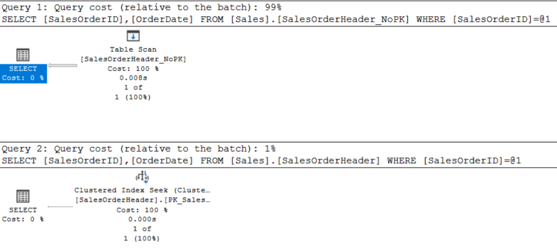

EXAMPLE 1
SELECT
SalesOrderID
,OrderDate
FROM Sales.SalesOrderHeader
WHERE SalesOrderID = 68864;

Slide 21
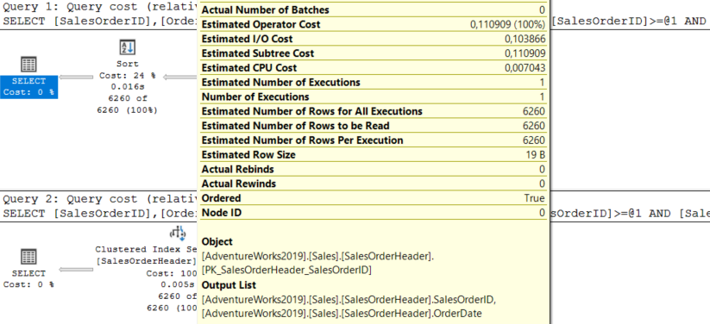
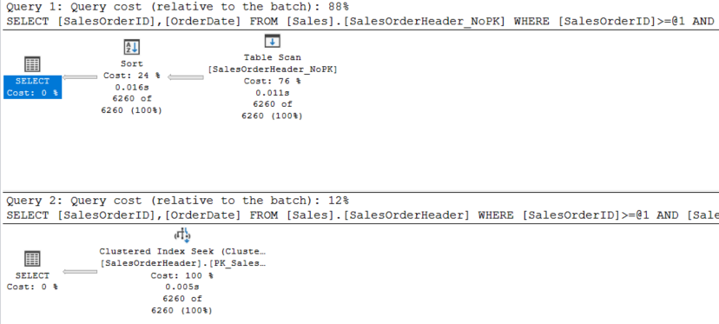
EXAMPLE 2
SELECT *
SalesOrderID
,OrderDate
FROM Sales.SalesOrderHeader
WHERE SalesOrderID >= 68864
AND SalesOrderID <= 90000
ORDER BY SalesOrderID;
whoops

Slide 22

Characteristics of a clustered index
doesn’t have to be unique
limit the number of columns
preferably small data types
preferably unique and NOT NULL
preferably high cardinality
columns ordered from the most distinct to the least
OLTP
typically the PK
OLAP
surrogate key in dimensions
fact table: it depends
apply (page) compression to save space

Slide 23
Nonclustered Indexes

Slide 24
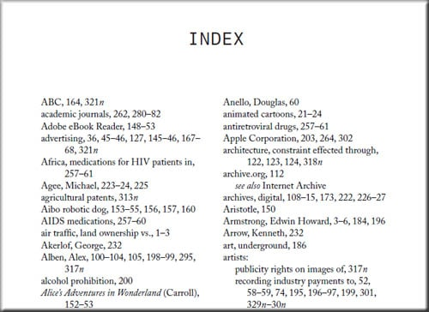

Slide 25
non-clustered index
E
C
G
B
D
F
H
A
B
C
D
E
F
G
H
Table Data / Clustered Index
Data Page
Data Page
Data Page
Data Page
Data Page
Data Page
Data Page
Data Page

Slide 26
Basic syntax
CREATE [UNIQUE] NONCLUSTERED INDEX NCI_myindex ON myschema.mytable(column1 ASC, column2 DESC, …) [WITH (DATA_COMPRESSION = PAGE)];

Slide 27
Characteristics of a nonclustered index
doesn’t have to be unique
you can have many different nonclustered indexes (NCI) on the same table
limit the number of columns
preferably small data types
preferably unique and NOT NULL
preferably high cardinality
columns ordered from the most distinct to the least
OLTP: foreign keys + uniqueness + any performance tuning
OLAP: uniqueness (business key in dim) + any performance tuning
try to make the index covering
if clustered index present, its keys are included in the NCI

Slide 28
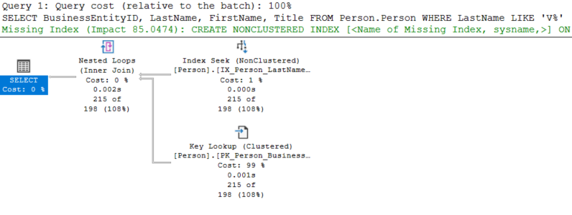
What is a covering index?
SELECT BusinessEntityID, LastName, FirstName, Title FROM Person.Person WHERE LastName LIKE 'V%';
not good

Slide 29
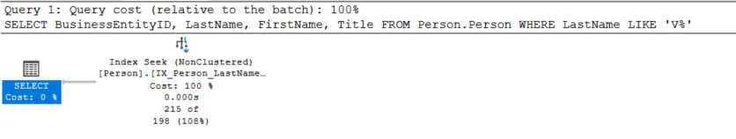
INCLUDE columns to the rescue!
CREATE NONCLUSTERED INDEX IX_Person_LastName_Covering ON Person.Person (LastName ASC) INCLUDE(FirstName, Title);

Slide 30
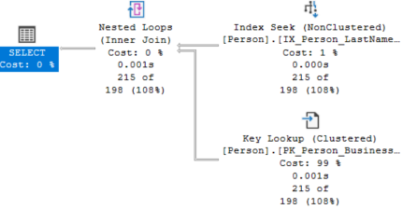
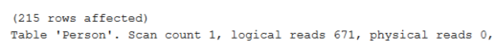
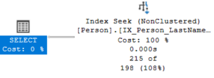
EXAMPLE 3
SELECT BusinessEntityID, LastName, FirstName, Title FROM Person.Person WHERE LastName LIKE 'V%';

Slide 31
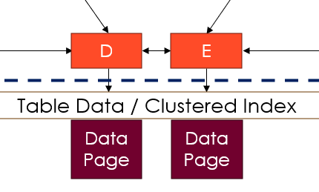
CI keys are in every NCI
Notice how the column BusinessEntityID wasn’t included, yet the index was still covering?
row locator heap: row ID
CI: index keys

Slide 32
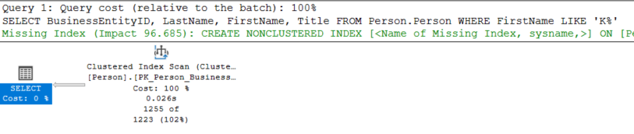
NCI Tips & Tricks
Column order matters!
is not the same as
CREATE NONCLUSTERED INDEX NCI_1 ON myschema.mytable(column1 ASC, column2 ASC)
CREATE NONCLUSTERED INDEX NCI_2 ON myschema.mytable(column2 ASC, column1 ASC)

Slide 33

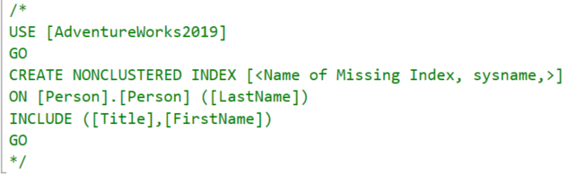
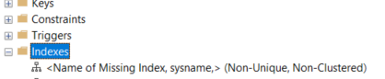
NCI Tips & Tricks
Check out (but don’t trust) missing index suggestions
DMV query to find all missing indexes in MS Learn

Slide 34
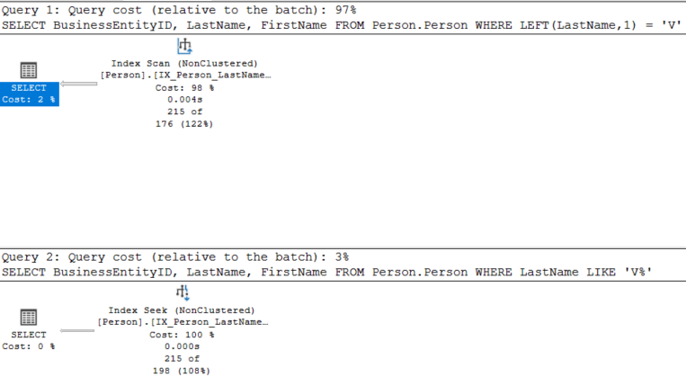


NCI Tips & Tricks
SARGable queries (Search ARGument ABLE)
write your predicates in such a way that an index can actually be used
SELECT BusinessEntityID, LastName , FirstName FROM Person.Person WHERE LEFT(LastName,1) = 'V';
SELECT BusinessEntityID, LastName , FirstName FROM Person.Person WHERE LastName LIKE 'V%';

Slide 35
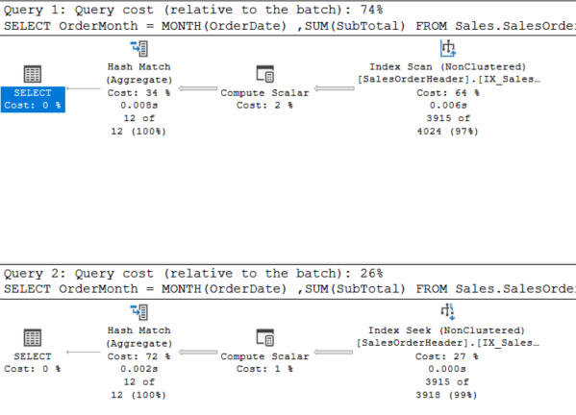
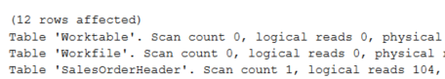
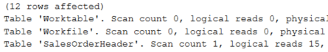
EXAMPLE 4
SELECT
OrderMonth = MONTH(OrderDate)
,SUM(SubTotal)
FROM Sales.SalesOrderHeader
WHERE YEAR(OrderDate) = 2012
GROUP BY MONTH(OrderDate);
SELECT
OrderMonth = MONTH(OrderDate)
,SUM(SubTotal)
FROM Sales.SalesOrderHeader
WHERE OrderDate >= '2012-01-01'
AND OrderDate < '2013-01-01'
GROUP BY MONTH(OrderDate);

Slide 36
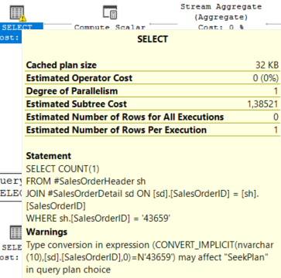
NCI Tips & Tricks
SARGable queries (Search ARGument ABLE)
also be aware of implicit conversions!

Slide 37
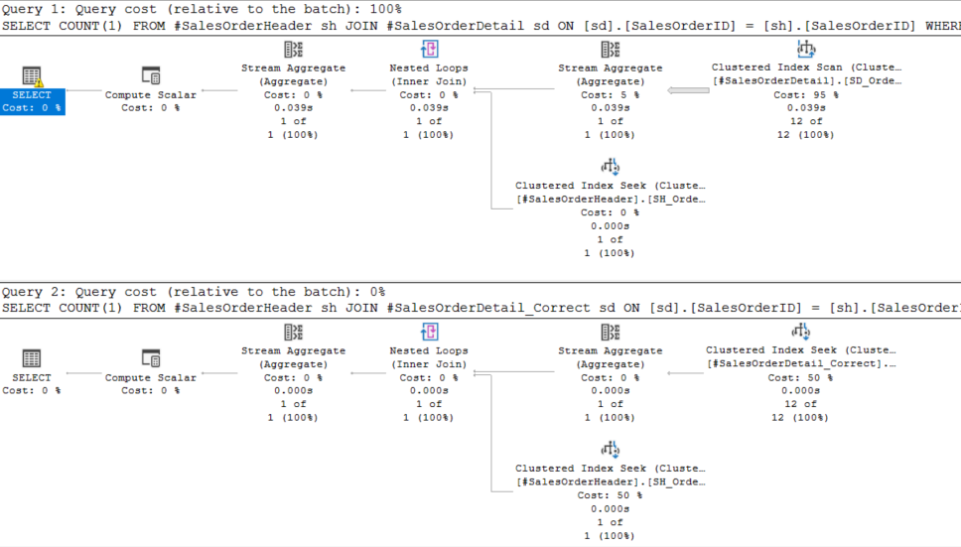
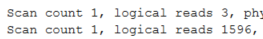
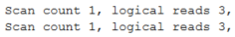
EXAMPLE 5
SELECT COUNT(1)
FROM #SalesOrderHeader sh
JOIN #SalesOrderDetail sd
ON sd.SalesOrderID = sh.SalesOrderID
WHERE sh.[SalesOrderID] = '43659';

Slide 38
NCI Tips & Tricks
Filtered Indexes
consume less disk space & less maintenance
queries frequently access only a portion of the data
columns with sparse data
uniqueness on a subset of the data
CREATE NONCLUSTERED INDEX IX_Orders_Status
ON dbo.Orders(OrderDate)
WHERE [Status] = 'Pending';
CREATE NONCLUSTERED INDEX IX_ProductColor
ON dbo.Products(Color)
WHERE Color IS NOT NULL;
CREATE UNIQUE INDEX UX_User_Active
ON dbo.Users(UserID)
WHERE IsActive = 1;

Slide 39
Other Indexes

Slide 40
Rowstore index
SELECT A
FROM mytable;
A
A
A
A
A
A
A
A
A
A
B
C
D
A
B
C
D
A
B
C
D
A
B
C
D
A
B
C
D
A
B
C
D
A
B
C
D
A
B
C
D
A
B
C
D
page
page
page
disk
Notes:
CI is a memory-optimized columnar storage for an index
It’s particularly aimed at data warehouses.
It can drastically improve performance. BTW they are not exactly “in-memory”.
The example here is typical rowstorage, as we have known it for years.

Slide 41
Columnstore index - less I/O
SELECT A
FROM mytable;
A
B
C
D
A
B
C
D
A
B
C
D
A
B
C
D
A
B
C
D
A
B
C
D
A
B
C
D
A
B
C
D
A
B
C
D
disk
Notes:
Because the data is stored as columns, it can be compressed much better. Since the compression is much better, more data can fit into memory. Also, a CI allows you to read only the columns that you actually need, reducing IO drastically.

Slide 42
Columnstore index syntax
CREATE CLUSTERED COLUMNSTORE INDEX myCCI
ON dbo.myTable
[ORDER column1, ...]
[WITH(DATA_COMPRESSION=COLUMNSTORE|COLUMNSTORE_ARCHIVE)];
CREATE NONCLUSTERED COLUMNSTORE INDEX myCCI
ON dbo.myTable
[ORDER column1, ...]
[WHERE <filter_expression>]
[WITH(DATA_COMPRESSION=COLUMNSTORE|COLUMNSTORE_ARCHIVE)];
Be sure to check MS Learn (also here) to verify limitations between different versions and products

Slide 43
Columnstore index - internals
A
B
C
D
group of rows compressed at the same time
A
B
C
D
A
B
C
D
rowgroup
A
B
D
maximum of 1,048,576 rows
A
D
D
C
B
C
column of data within rowgroup
A
B
C
min/max values are kept
A
B
C
D
column segment
A
B
C
D
A
B
C
D
Notes:
1,048,576 = 1024 * 1024
Big enough for good compression, small enough to fit into memory

Slide 44
Columnstore index - internals
delete bitmap
A
B
C
D
A
B
C
D
A
B
C
D
compressed rowgroup
+
A
B
D
A
D
D
deltastore (row storage)
delete bitmap
C
B
C
A
B
C
A
B
C
D
A
B
C
D
A
B
C
D

Slide 45
Columnstore index - segment elimination
100
A
B
C
D
A
B
C
D
SELECT A,B,C,D
FROM myTable
WHERE D = 130;
A
B
C
D
A
B
D
A
D
D
150
C
B
C
A
B
C
151
A
B
C
D
A
B
C
D
A
B
C
D
170
Notes:
Segment elimination. If you have large rowgroups in a small table, scanning the entire rowgroup probably isn’t as efficient as a normal B-tree index.
In reality, this is hard to achieve because not all your columns are sorted. Trick: apply clustered index to one column, than apply CCI → data is sorted according to orginal clustered index.

Slide 46
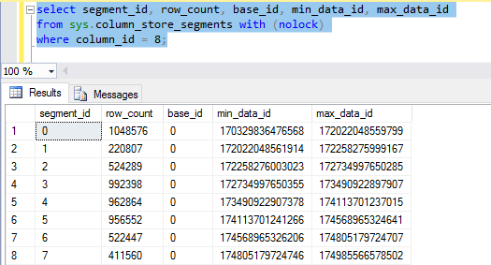
Columnstore index - segment elimination

Slide 47
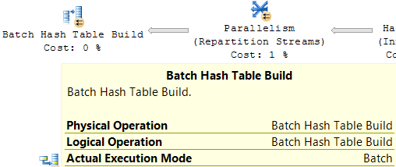
Batch mode FTW
Processes rows in batches of ~900 rows
Ideal for data warehousing scenarios
Since SQL Server 2019+ (and Azure SQL DB), also available for tables that don’t have a columnstore index

Slide 48
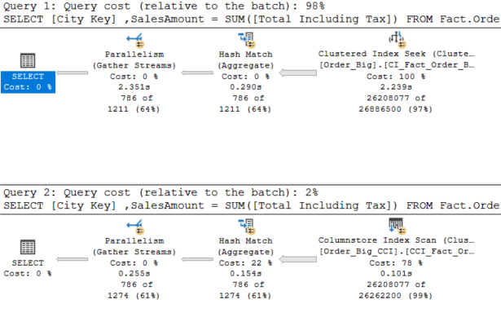
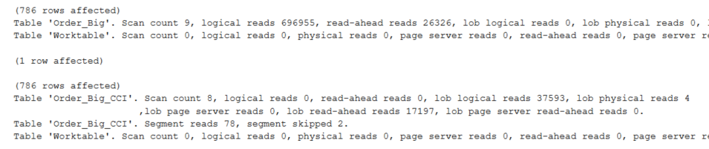
Columnstore index
EXAMPLE 6
SELECT
[City Key]
,SalesAmount = SUM([Total Including Tax])
FROM Fact.Order_Big
WHERE [Order Date Key] >= '2015-01-01'
AND [Order Date Key] < '2016-01-01'
GROUP BY [City Key];

Slide 49
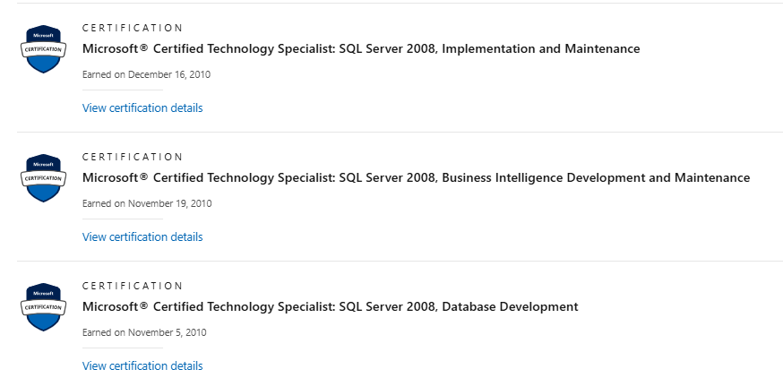
Lesser-known index types
XML index
primary and secondary index
on values, paths or properties
never encountered one in real-life
Spatial index
for either geometry or geography
quite complicated imo
also never seen one
Full-text index
only one per table, but up to 1024 columns
this technology is probably outdated
like the other two, I’ve only seen this on certification exams

Slide 50
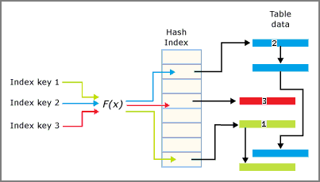
Lesser-known index types
Hash index
every memory-optimized table needs at least one index
either hash or nonclustered
array of pointers
database engine has one hash function
needs a bucket count
defined using ALTER TABLE
ALTER TABLE my_MemoryOptimizedTabl
ADD INDEX ix_hash_myColumn
UNIQUE NONCLUSTERED HASH (myColumn)
WITH (BUCKET_COUNT = 64);

Slide 51
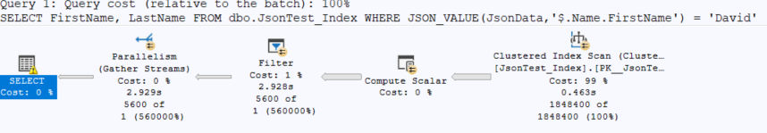
The new kid on the block: JSON index
SQL Server 2025 introduces the JSON data type
which already exists in Azure SQL DB/MI and Fabric SQL DB
… but getting the index to work can be tricky
CREATE JSON INDEX ix_json ON dbo.JsonTest_Index(JsonData) FOR ('$.Name.FirstName');
not the index we’re looking for

Slide 52
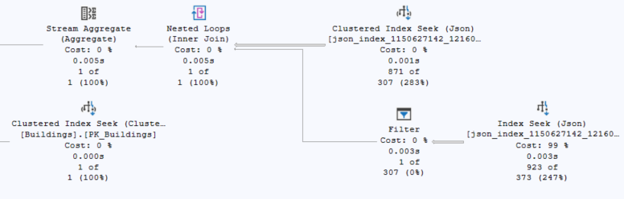
JSON index
From Daniel Hutmacher’s blog post JSON indexes in SQL Server: First Impressions
CREATE JSON INDEX IX_JSON
ON Chicago.Buildings(JSON_blob)
FOR ('$.streetName', '$.streetAddresses')
WITH (DATA_COMPRESSION=PAGE);
SELECT COUNT(1)
FROM Chicago.Buildings
WHERE JSON_CONTAINS(JSON_blob, 'S La Salle St', '$.streetName')=1
AND JSON_CONTAINS(JSON_blob, 209, '$.streetAddresses[*]')=1;

Slide 53
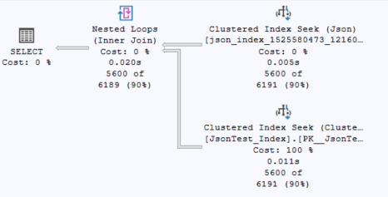
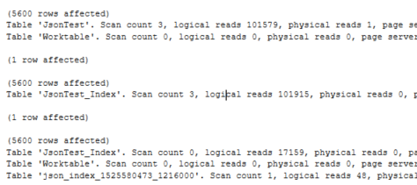
JSON index
EXAMPLE 7
Try JSON_CONTAINS instead of JSON_VALUE
SELECT FirstName, LastName
FROM dbo.JsonTest_Index
WHERE JSON_CONTAINS(JsonData,'David','$.Name.FirstName') = 1;

Slide 54
Indexes in Other Engines

Slide 55
All the indexes we’ve seen so far…
… are available in the latest editions of SQL Server
except for the JSON index which is only available in SQL Server 2025
all of them (except JSON) are also available in the following products:
Azure SQL Database
Azure SQL Managed Instance
Fabric SQL Database

Slide 56
Synapse Dedicated SQL Pool
By default, clustered columnstore index
If you want a heap, you need to explicitly specify it
Likewise, for (non)clustered (rowstore) index
CREATE TABLE dbo.myTable(
id INT NOT NULL
,mycolumn VARCHAR(20)
)
WITH (HEAP);
CREATE TABLE dbo.myTable(
id INT NOT NULL
,mycolumn VARCHAR(20)
)
WITH (CLUSTERED INDEX (id));

Slide 57
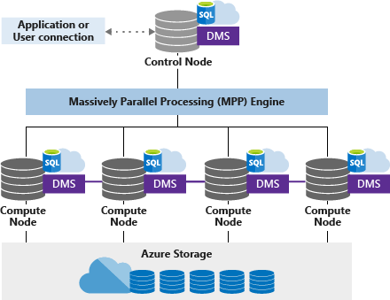
Dedicated SQL Pool - Distribution
By default, clustered columnstore index
But data is also distributed over compute nodes
Dedicated SQL Pool architecture

Slide 58
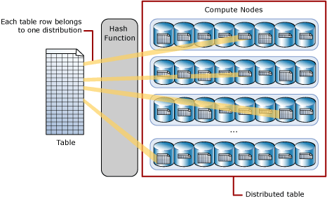
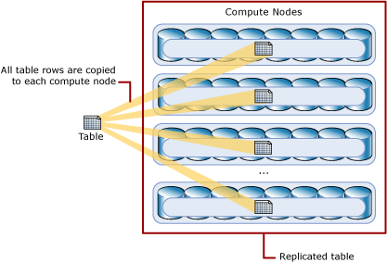
Dedicated SQL Pool - Distribution
There are 3 possible distributions:
round-robin (default)
hash (ideal for facts)
replicate (ideal for dimensions)
Dedicated SQL Pool architecture
CREATE TABLE dbo.myTable(
id INT NOT NULL
,mycolumn VARCHAR(20)
)
WITH (DISTRIBUTION=HASH(mycolumn));

Slide 59

Dedicated SQL Pool - Constraints
There are no primary, foreign or unique keys
well, you can create them, but they’re not enforced
this is actually quite common in cloud distributed data warehouses
ALTER TABLE dbo.myTable
ADD CONSTRAINT PK_myTable PRIMARY KEY CLUSTERED(id) NOT ENFORCED

Slide 60

Fabric Warehouse
Data is stored as Parquet files using the delta transaction layer
There are no indexes
Due to the nature of Parquet and its compression, it’s similar to having a clustered columnstore index
You can create constraints but they’re not enforced, like in Dedicated SQL Pool
Shift in mentality on how to improve performance
Performance guidelines in Fabric Data Warehouse

Slide 61
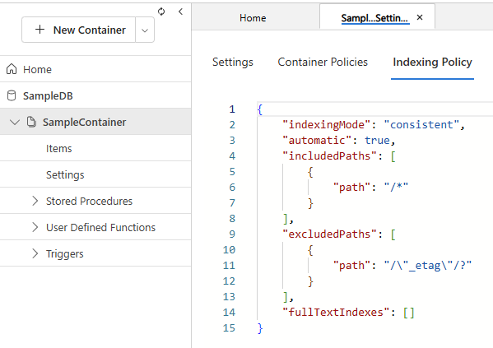
Cosmos DB
In the NoSQL API, you can also create a “JSON index” through an indexing policy

Slide 62
Maintenance

Slide 63
Index Fragmentation
Indexes become fragmented over time due to inserts, updates and deletes
Fragmentation can be resolved with
REORGANIZE - defragments leaf level of the index
REBUILD - drops and recreates the index
FILLFACTOR - index option that specifies how much space in a leaf index page should be taken e.g. 80% → the index page is 20% empty at creation
ALTER INDEX IX_myindex ON dbo.myTable REORGANIZE;
ALTER INDEX IX_myindex ON dbo.myTable REBUILD;
ALTER INDEX ALL ON dbo.myTable REBUILD;

Slide 64
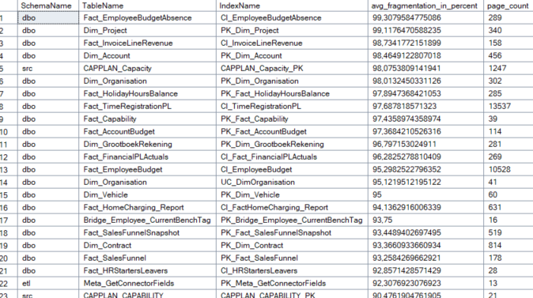
Index Fragmentation
Check health of an index with sys.dm_db_index_physical_stats

Slide 65
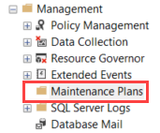
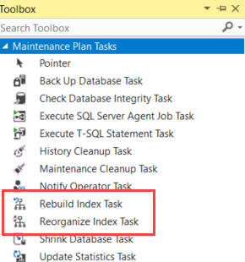
Automated solutions
Maintenance Plans
uses SSIS behind the scenes
allows to schedule multiple tasks, with conditions
Ola Hellengren’s SQL Server Maintenance Solution

Slide 66
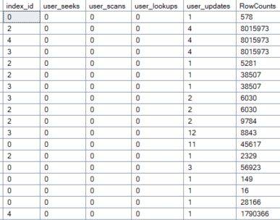
Unused indexes
You can check the usage of an index with sys.dm_db_index_usage_stats
sp_BlitzIndex ® checks for duplicate/unused indexes, wide clustering keys etc.

Slide 67
Conclusion

Slide 68
Conclusion
Indexes are crucial for good query performance in a relational database
Many different types of indexes, but most important ones are:
clustered index (only one per table)
nonclustered index
columnstore index
In modern cloud data warehouses, indexes are typically not supported
architecture-wise, some resemble columnstore indexes
Check what the options are in your type and version of database
Don’t forget maintenance!

Slide 69
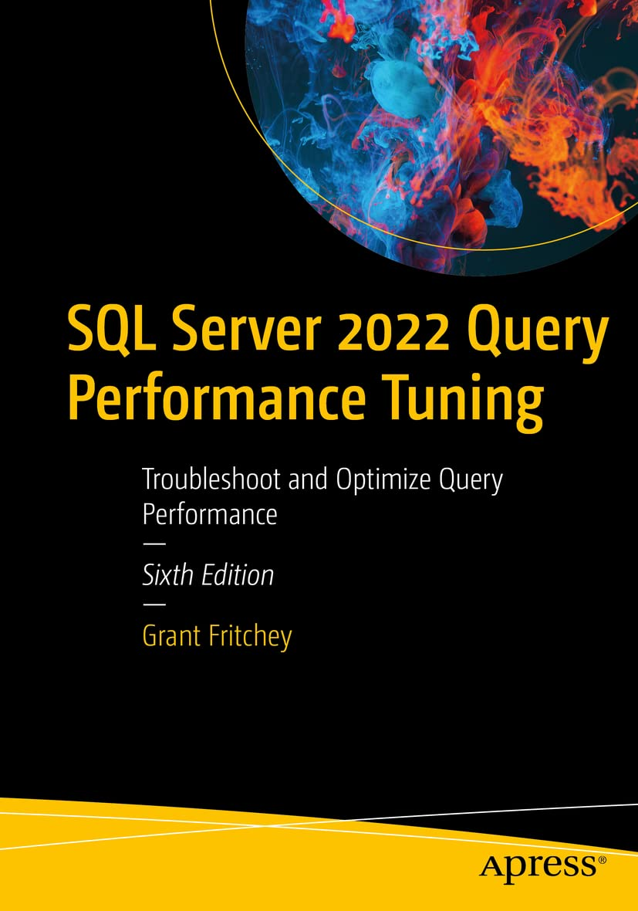
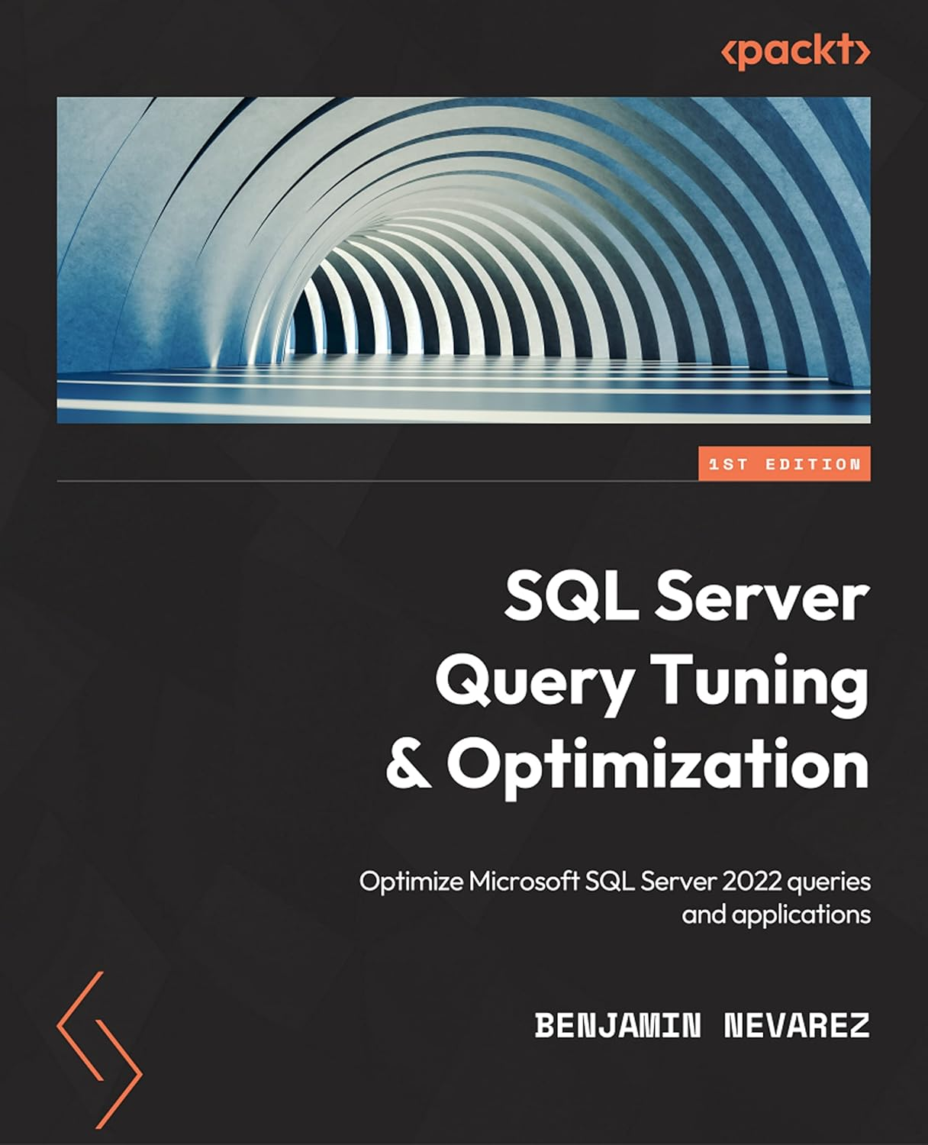
Resources
SQL Server and Azure SQL index architecture and design guide
Indexes on MS Learn
Clustered and nonclustered indexes
SQL Server Clustered Indexes internals with examples
Columnstore Indexes
JSON indexes in SQL Server: First impressions
https://ola.hallengren.com/
Free First Responder Kit

Slide 70

www.ae.be inspire@ae.be +32 16 39 30 60
Interleuvenlaan 27b
3001 Heverlee

Slide 71
Session Feedback💖
https://bit.ly/dMC2025_SessionFeedback

